Slide 1
L4/5 Group 1
Alice Baker
Dragos Liche
Kenneth Pirkle
Jordan Carman

Slide 2

The Brief
2D Game
‘Simple tap’ twitch mechanic
2 player – on a single mobile device
Symmetric gameplay
Notes:
Alice

Slide 3
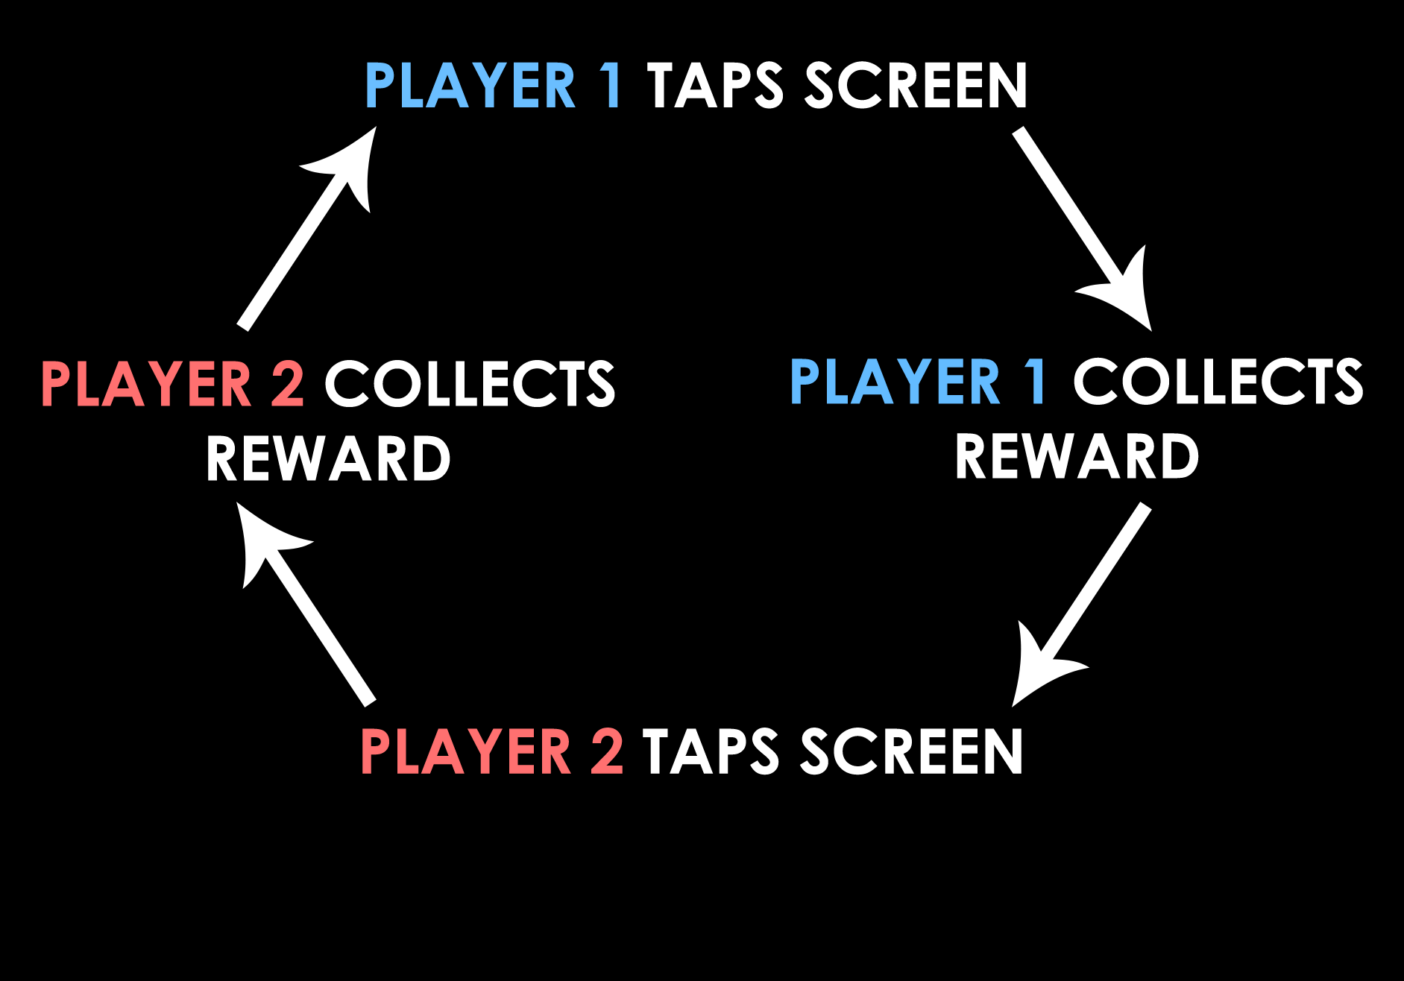
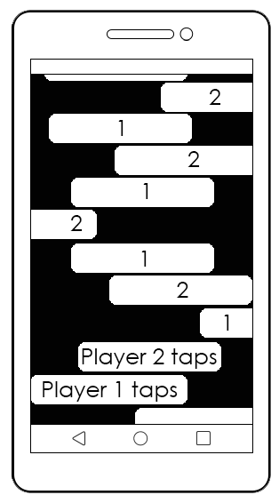
Core game loop
Notes:
Alice

Slide 4
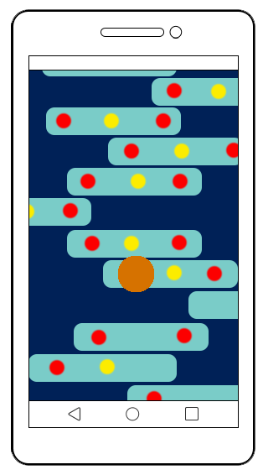

Initial Concept
Left: Points spread out on platforms
Players take turns to tap on the screen
Character jumps across moving platforms
Collect points in a limited time
Lose points if character falls
Notes:
Alice
Platforms move side to side
Points are a higher value closer to the edges

Slide 5
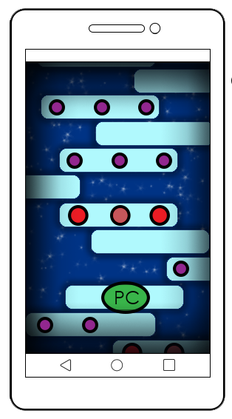

Iteration
Below:
Player 1 theme
Collect a choice of power-ups
Game ends when the character falls off a platform
Contrasting theme for each player
Above:
Player 2 theme
Notes:
Jordan
Still taking in turns to move character onto moving platforms
Points are higher value closer to the edges
Choice of power ups to sabotage or protect

Slide 6
Features
Power-ups for attack or defense
Art assets - Player character, background, platforms, points, powerups
Audio – background music, sound effects
Notes:
Jordan
Players can see points/power-ups on their own platforms, where platforms are blank is where the opponent will collect points/power ups
Player character controlled by both players - penguin
Points - parts/energy for their flying contraptions or fish
Power ups

Slide 7
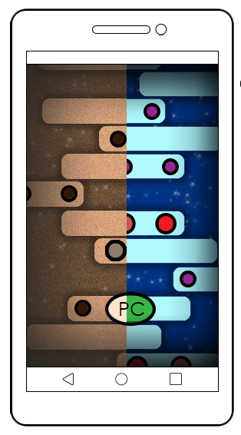
Who is the game for?
Male & Female, ages 10 – 35
‘People Fun’ – players compete by sabotaging each other
‘Hard Fun’ – progressively, challenging gameplay
Notes:
Alice
People fun – amusement when they sabotage each other
Hard fun – as well as power-ups that sabotage the player, the platform speed gets quicker. Fiero when a player wins, frustration if they lose. Relief when they land on a platform.

Slide 8
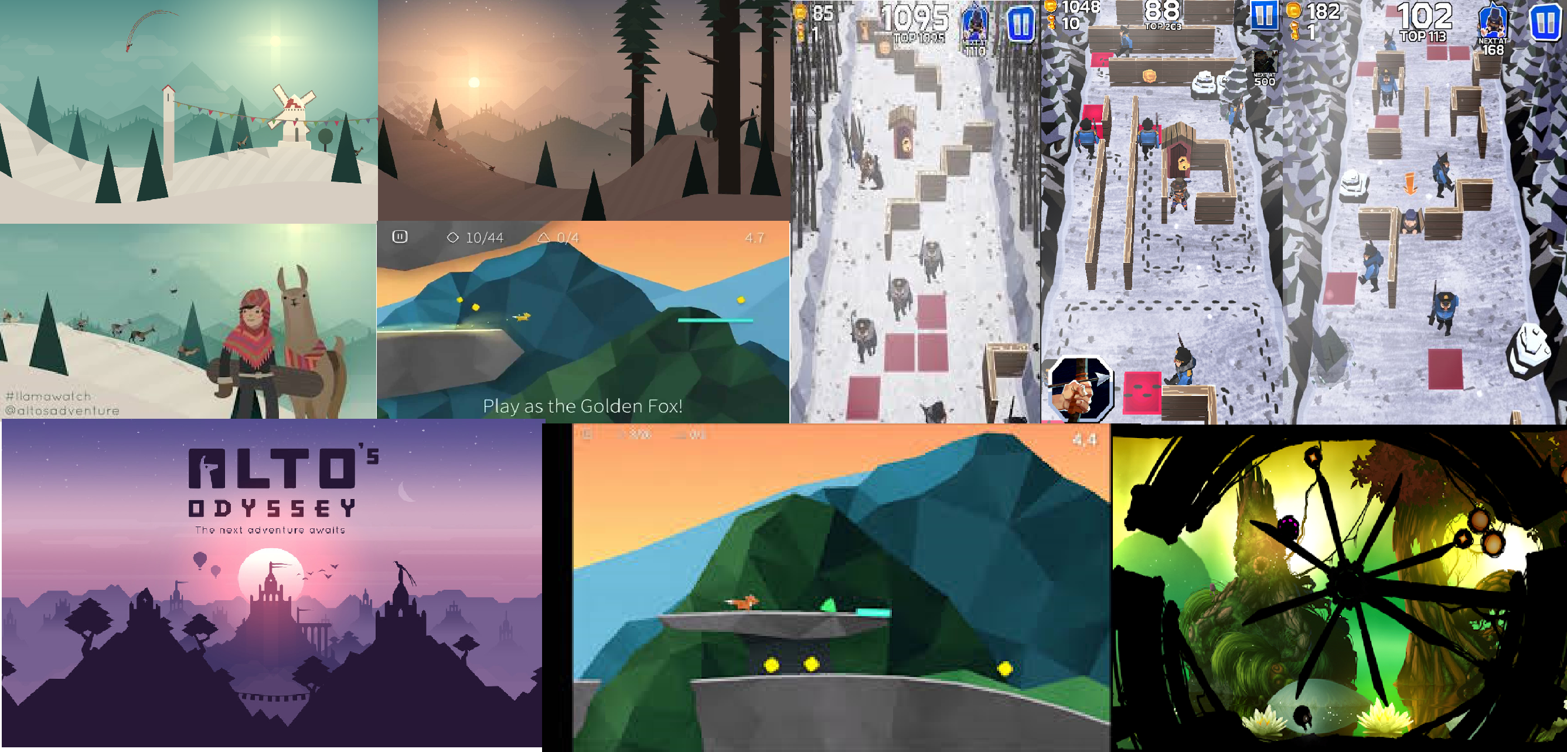
Art Style
Notes:
Dragos

Slide 9


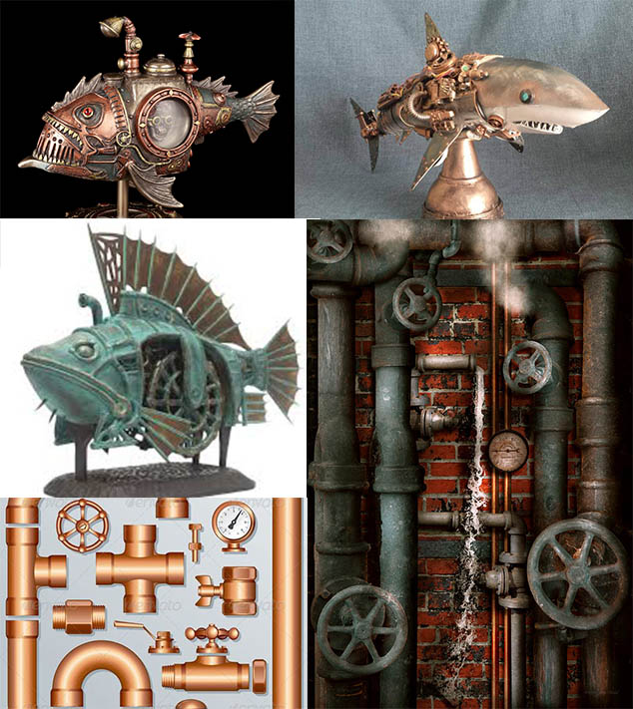
OLD ERA
Penguin uses flying contraption
Enemies underwater
Notes:
Dragos

Slide 10
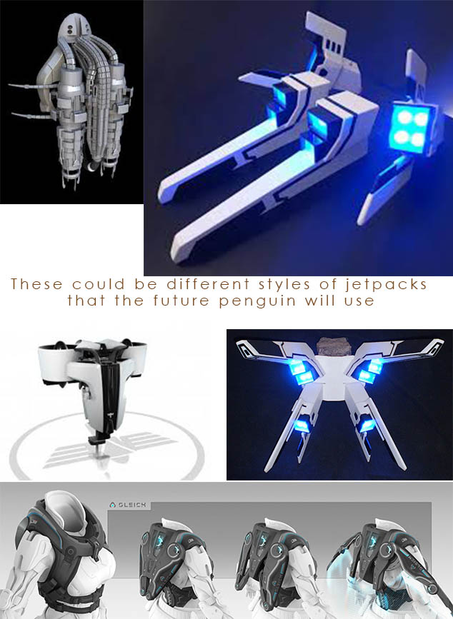
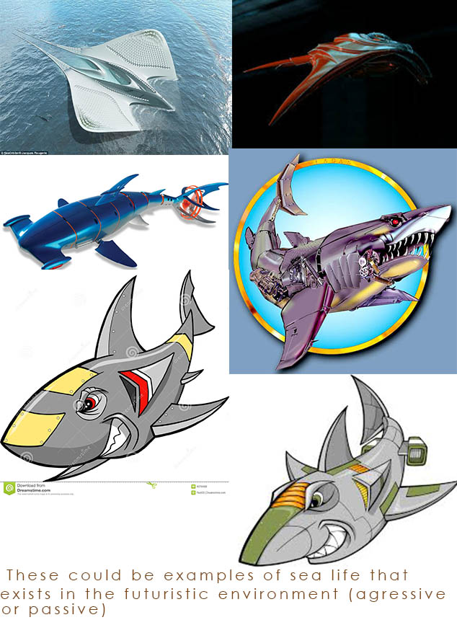
new ERA
Penguin uses flying contraption
Enemies underwater
Notes:
Dragos

Slide 11
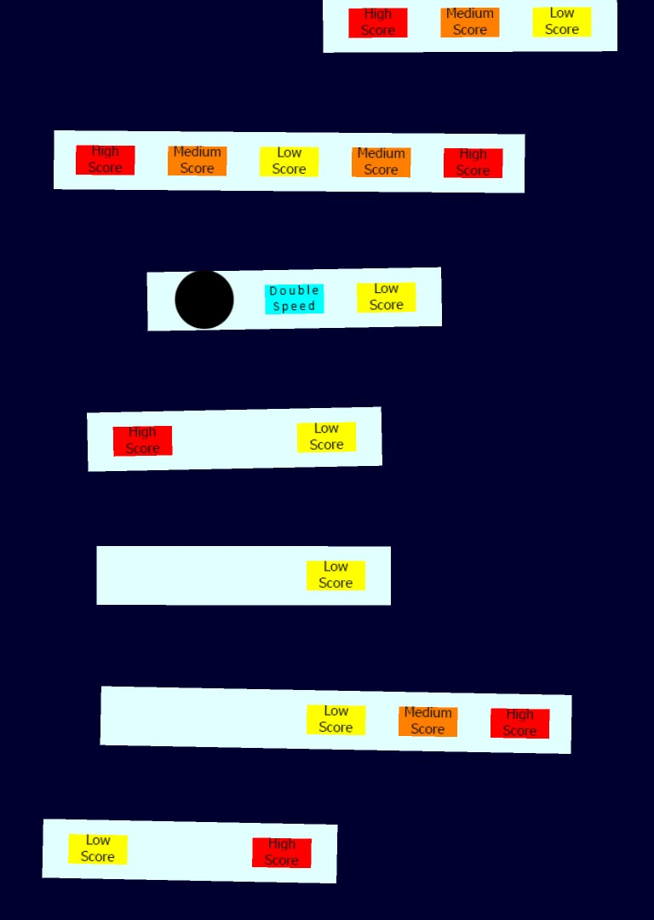
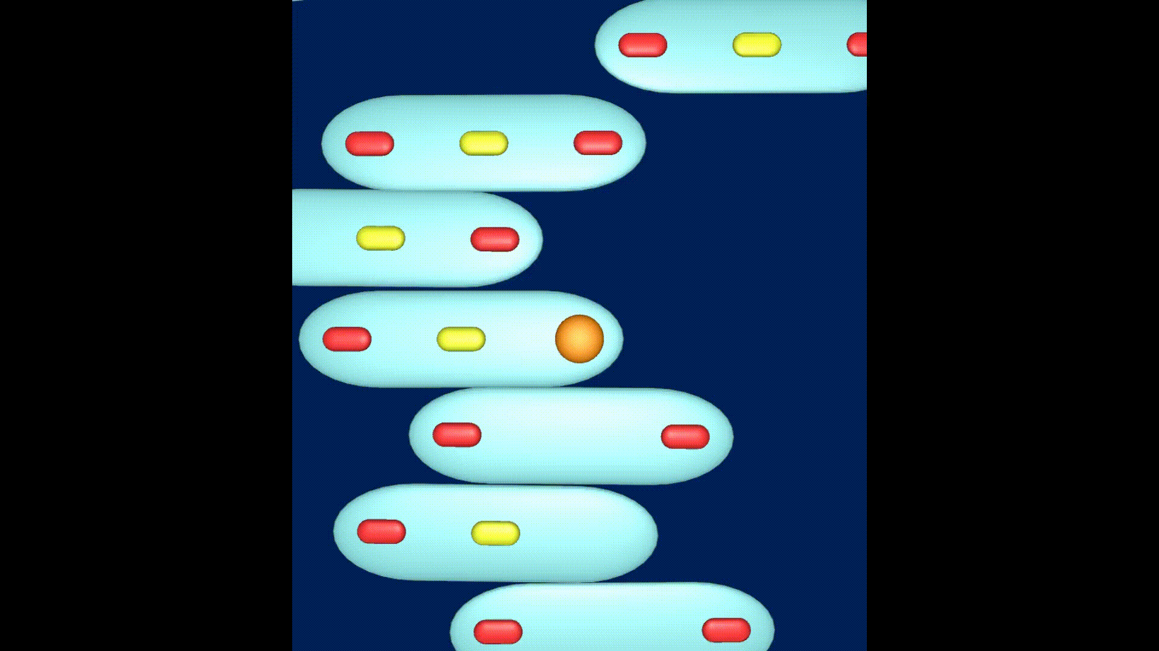
Prototype
Notes:
Ken and Jordan

Slide 12
MANAGEMENT
Hours of logged work
Alice – 25h 5m
Dragos – 28h 35m
Jordan – 22h 25m
Ken – 11h
Emails sent
Alice – 38
Dragos – 16
Jordan – 33
Ken – 14
Notes:
Alice

Slide 13
Thanks for watching!
Any questions?
Notes:
Alice

